Slide 1
Galaxy Buds2
Modify
Authoring Guide
- P6 Standard feature HTML
Brief date : 29th February, 2024

Slide 2
PSD

Slide 3
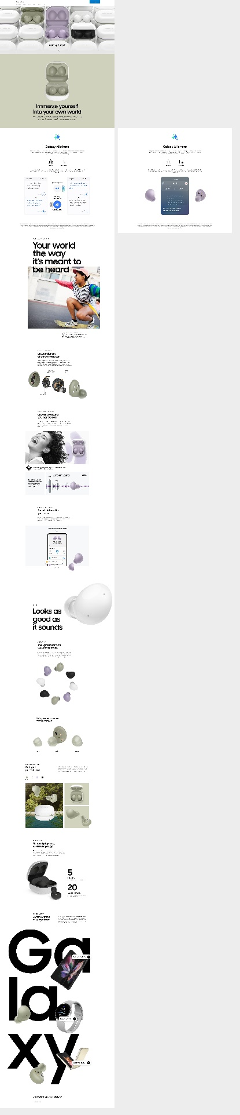
Highlights > Screen(UVI)
[contents update] Galaxy AI is here feature is added

Slide 4
HTML/CSS/JS and Media file
From mark-up

Slide 5
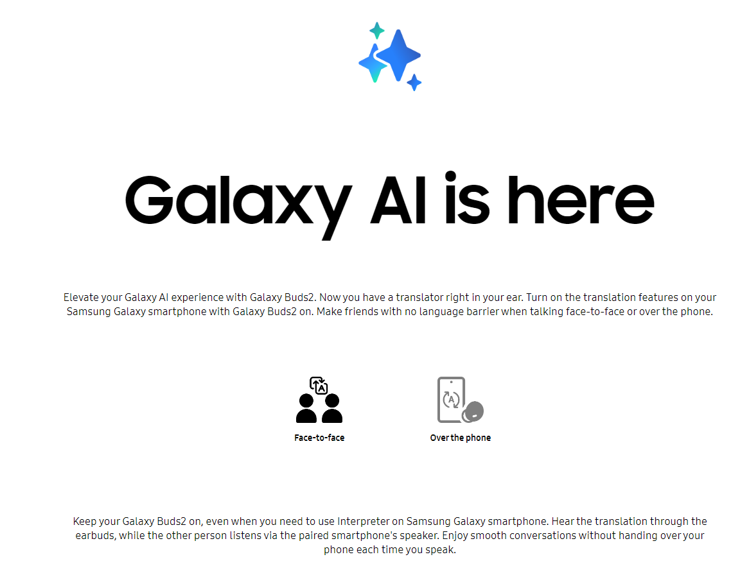
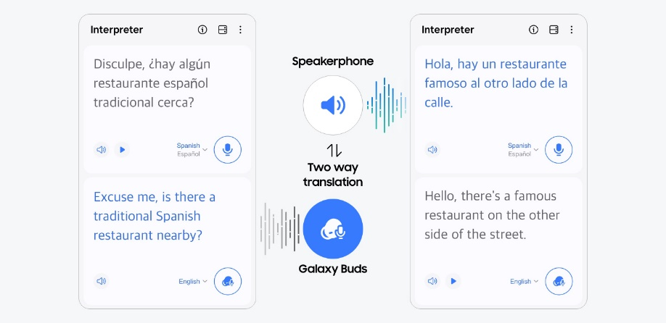
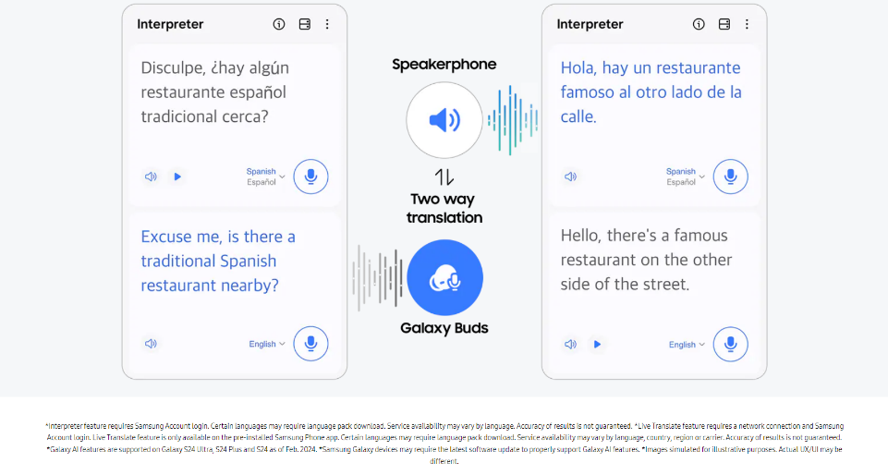
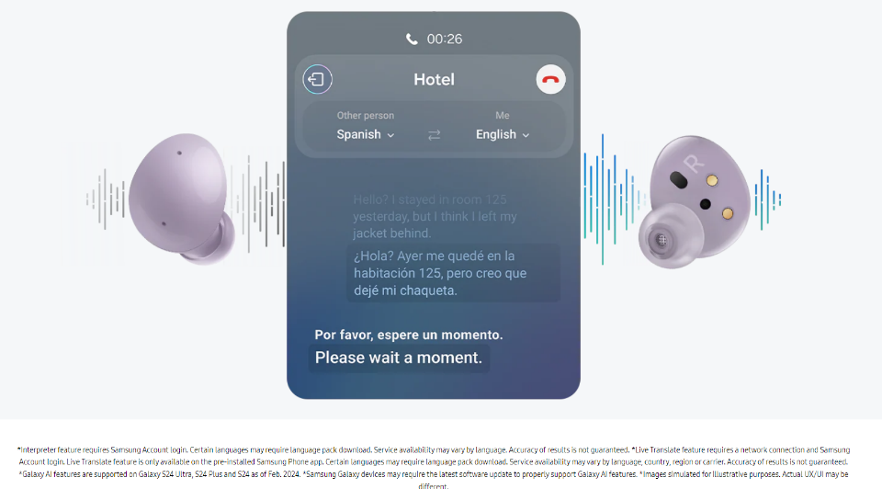
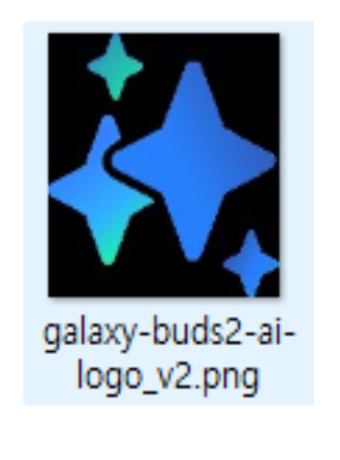

Galaxy Buds2 > Galaxy AI is here [images Assest]
[contents update] Galaxy AI is here feature is added
images/galaxy-buds2-ai-logo_v2
galaxy-buds2-ai-logo.png
Notes:
[AS-WAS]
images/galaxy-buds2-ai-face-to-face
images/galaxy-buds2-ai-facetoface-active0
images/galaxy-buds2-ai-facetoface-default0
images/galaxy-buds2-ai-logo
images/galaxy-buds2-ai-over-the-phone
Images/galaxy-buds2-ai-overthephone-active0
images/galaxy-buds2-ai-overthephone-default0
[TO-BE]
images/galaxy-buds2-ai-face-to-face
images/galaxy-buds2-ai-facetoface-active0
images/galaxy-buds2-ai-facetoface-default0
images/galaxy-buds2-ai-logo_v2
images/galaxy-buds2-ai-over-the-phone
Images/galaxy-buds2-ai-overthephone-active0
images/galaxy-buds2-ai-overthephone-default0

Slide 6
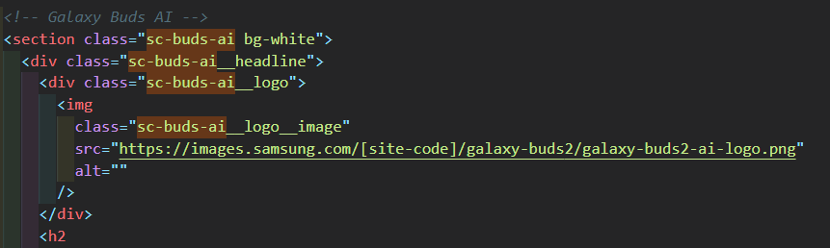
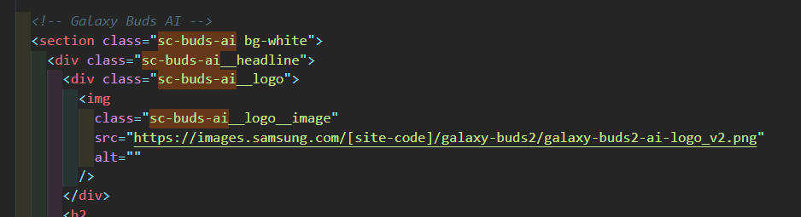
Galaxy Buds2 > Galaxy AI is here [HTML Code]
[contents update] Galaxy AI is here feature is added
codes/index_pim.html
Notes:
[AS-WAS]
<!-- Galaxy Buds AI -->
<section class="sc-buds-ai bg-white">
<div class="sc-buds-ai__headline">
<div class="sc-buds-ai__logo">
<img
class="sc-buds-ai__logo__image"
src="https://images.samsung.com/is/image/samsung/assets/test/mobile/2022-2h/galaxy-buds2/galaxy-buds2-ai-logo.png"
alt=""
/>
</div>
<h2
class="sc-buds-ai__title"
id="tabTitleId_01"
data-font-size-pc="64"
data-font-size-mo="70"
>
Galaxy AI is here
</h2>
<p class="sc-buds-ai__description">
Elevate your Galaxy AI experience with Galaxy Buds2. Now you have a
translator right in your ear. Turn on the translation features on your
Samsung Galaxy smartphone with Galaxy Buds2 on. Make friends with no
language barrier when talking face-to-face or over the phone.
</p>
</div>
<div class="sc-buds-ai__content">
<div
class="sc-buds-ai-list"
role="tablist"
aria-labelledby="tabTitleId_01"
>
<a
class="sc-buds-ai-list__anchor sc-buds-ai-list__anchor--active"
id="tabListId_0"
href="javascript:void(0);"
role="tab"
aria-selected="true"
aria-controls="tabPanelId_0"
onclick="toggleActiveTabPanelAi(this)"
onmouseenter="onActiveAi(this)"
onmouseleave="onInActiveAi(this)"
onkeypress="toggleActiveTabPanelAi(this)"
onfocus="onActiveAi(this)"
onblur="onInActiveAi(this)"
data-omni-type="microsite_contentinter"
data-omni="galaxy ai is here:face to face"
ga-ca="content click"
ga-ac="feature"
ga-la="galaxy ai is here:face to face"
>
<div class="sc-buds-ai-list__inner">
<div class="sc-buds-ai-list__icon">
<img
class="sc-buds-ai-list__image sc-buds-ai-list__image--active sc-buds-ai-list__anchor--active"
src="https://images.samsung.com/is/image/samsung/assets/test/mobile/2022-2h/galaxy-buds2/galaxy-buds2-ai-facetoface-active0.png"
alt=""
/>
<img
class="sc-buds-ai-list__image sc-buds-ai-list__image--default"
src="https://images.samsung.com/is/image/samsung/assets/test/mobile/2022-2h/galaxy-buds2/galaxy-buds2-ai-facetoface-active0.png"
alt=""
/>
</div>
<span class="sc-buds-ai-list__text">Face-to-face</span>
</div>
</a>
<a
class="sc-buds-ai-list__anchor"
id="tabListId_1"
href="javascript:void(0);"
role="tab"
aria-selected="false"
aria-controls="tabPanelId_1"
onclick="toggleActiveTabPanelAi(this)"
onmouseenter="onActiveAi(this)"
onmouseleave="onInActiveAi(this)"
onkeypress="toggleActiveTabPanelAi(this)"
onfocus="onActiveAi(this)"
onblur="onInActiveAi(this)"
data-omni-type="microsite_contentinter"
data-omni="galaxy ai is here:over the phone"
ga-ca="content click"
ga-ac="feature"
ga-la="galaxy ai is here:over the phone"
>
<div class="sc-buds-ai-list__inner">
<div class="sc-buds-ai-list__icon">
<img
class="sc-buds-ai-list__image sc-buds-ai-list__image--active"
src="https://images.samsung.com/is/image/samsung/assets/test/mobile/2022-2h/galaxy-buds2/galaxy-buds2-ai-overthephone-active0.png"
alt=""
/>
<img
class="sc-buds-ai-list__image sc-buds-ai-list__image--default"
src="https://images.samsung.com/is/image/samsung/assets/test/mobile/2022-2h/galaxy-buds2/galaxy-buds2-ai-overthephone-active0.png"
alt=""
/>
</div>
<span class="sc-buds-ai-list__text">Over the phone</span>
</div>
</a>
</div>
<div
class="sc-buds-ai-panel sc-buds-ai-panel--active"
id="tabPanelId_0"
role="tabpanel"
aria-hidden="false"
aria-labelledby="tabListId_0"
>
<div class="sc-buds-ai-list__description">
Keep your Galaxy Buds2 on, even when you need to use Interpreter on Samsung Galaxy smartphone. Hear the translation through the earbuds, while the other person listens via the paired smartphone's speaker. Enjoy smooth conversations without handing over your phone each time you speak.
</div>
<figure class="sc-buds-ai-panel__figure">
<div class="image image--main-loaded sc-buds-ai-inner-box">
<img
class="image__main responsive-img image--loaded"
data-desktop-src="https://images.samsung.com/is/image/samsung/assets/test/mobile/2022-2h/galaxy-buds2/galaxy-buds2-ai-facetoface-0305_pc.png"
data-mobile-src="https://images.samsung.com/is/image/samsung/assets/test/mobile/2022-2h/galaxy-buds2/galaxy-buds2-ai-facetoface-0305_mo.png"
alt="GUIs of Interpreter app can be seen, with translated English and Spanish onscreen. Between the GUIs are text and icons that indicate two-way translation through speakerphone and Galaxy Buds."
src="https://images.samsung.com/is/image/samsung/assets/test/mobile/2022-2h/galaxy-buds2/galaxy-buds2-ai-facetoface-0305_pc.png"
/>
</div>
</figure>
<span class="sc-buds-ai__disclaimer sc-buds-ai-inner-box"
>*Interpreter feature requires Samsung Account login. Certain
languages may require language pack download. Service availability may
vary by language. Accuracy of results is not guaranteed. *Live
Translate feature requires a network connection and Samsung Account
login. Live Translate feature is only available on the pre-installed
Samsung Phone app. Certain languages may require language pack
download. Service availability may vary by language, country, region
or carrier. Accuracy of results is not guaranteed. *Galaxy AI features
are supported on Galaxy S24 Ultra, S24 Plus and S24 as of Feb. 2024.
*Samsung Galaxy devices may require the latest software update to
properly support Galaxy AI features. *Images simulated for
illustrative purposes. Actual UX/UI may be different.
</span>
</div>
<div
class="sc-buds-ai-panel"
id="tabPanelId_1"
role="tabpanel"
aria-hidden="true"
aria-labelledby="tabListId_1"
>
<div class="sc-buds-ai-list__description">
Galaxy Buds2&apos;s mics pick up your words clearly during Live
Translation calls, thanks to a voice recognition algorithm. Then Live
Translate on the paired Samsung Galaxy smartphone interprets to the
language that&apos;s being used. Read the dialog without holding your
phone up to your ears.
</div>
<figure class="sc-buds-ai-panel__figure">
<div class="image image--main-loaded sc-buds-ai-inner-box">
<img
class="image__main responsive-img image--loaded"
data-desktop-src="https://images.samsung.com/is/image/samsung/assets/test/mobile/2022-2h/galaxy-buds2/galaxy-buds2-ai-overthephone_pc.png"
data-mobile-src="https://images.samsung.com/is/image/samsung/assets/test/mobile/2022-2h/galaxy-buds2/galaxy-buds2-ai-overthephone_mo.png"
alt="Earbuds of Galaxy Buds2 in Lavendar can be seen. Between the earbuds is GUI of Live Translate. In the background are sound waves that indicate Live Translation."
src="https://images.samsung.com/is/image/samsung/assets/test/mobile/2022-2h/galaxy-buds2/galaxy-buds2-ai-overthephone_pc.png"
/>
</div>
</figure>
<span class="sc-buds-ai__disclaimer sc-buds-ai-inner-box"
>*Interpreter feature requires Samsung Account login. Certain
languages may require language pack download. Service availability may
vary by language. Accuracy of results is not guaranteed. *Live
Translate feature requires a network connection and Samsung Account
login. Live Translate feature is only available on the pre-installed
Samsung Phone app. Certain languages may require language pack
download. Service availability may vary by language, country, region
or carrier. Accuracy of results is not guaranteed. *Galaxy AI features
are supported on Galaxy S24 Ultra, S24 Plus and S24 as of Feb. 2024.
*Samsung Galaxy devices may require the latest software update to
properly support Galaxy AI features. *Images simulated for
illustrative purposes. Actual UX/UI may be different.
</span>
</div>
</div>
</section>
[TO-BE]
<!-- Galaxy Buds AI -->
<section class="sc-buds-ai bg-white">
<div class="sc-buds-ai__headline">
<div class="sc-buds-ai__logo">
<img
class="sc-buds-ai__logo__image"
src="https://images.samsung.com/is/image/samsung/assets/test/mobile/2022-2h/galaxy-buds2/galaxy-buds2-ai-logo_v2.png"
alt=""
/>
</div>
<h2
class="sc-buds-ai__title"
id="tabTitleId_01"
data-font-size-pc="64"
data-font-size-mo="70"
>
Galaxy AI is here
</h2>
<p class="sc-buds-ai__description">
Elevate your Galaxy AI experience with Galaxy Buds2. Now you have a
translator right in your ear. Turn on the translation features on your
Samsung Galaxy smartphone with Galaxy Buds2 on. Make friends with no
language barrier when talking face-to-face or over the phone.
</p>
</div>
<div class="sc-buds-ai__content">
<div
class="sc-buds-ai-list"
role="tablist"
aria-labelledby="tabTitleId_01"
>
<a
class="sc-buds-ai-list__anchor sc-buds-ai-list__anchor--active"
id="tabListId_0"
href="javascript:void(0);"
role="tab"
aria-selected="true"
aria-controls="tabPanelId_0"
onclick="toggleActiveTabPanelAi(this)"
onmouseenter="onActiveAi(this)"
onmouseleave="onInActiveAi(this)"
onkeypress="toggleActiveTabPanelAi(this)"
onfocus="onActiveAi(this)"
onblur="onInActiveAi(this)"
data-omni-type="microsite_contentinter"
data-omni="galaxy ai is here:face to face"
ga-ca="content click"
ga-ac="feature"
ga-la="galaxy ai is here:face to face"
>
<div class="sc-buds-ai-list__inner">
<div class="sc-buds-ai-list__icon">
<img
class="sc-buds-ai-list__image sc-buds-ai-list__image--active sc-buds-ai-list__anchor--active"
src="https://images.samsung.com/is/image/samsung/assets/test/mobile/2022-2h/galaxy-buds2/galaxy-buds2-ai-facetoface-active0.png"
alt=""
/>
<img
class="sc-buds-ai-list__image sc-buds-ai-list__image--default"
src="https://images.samsung.com/is/image/samsung/assets/test/mobile/2022-2h/galaxy-buds2/galaxy-buds2-ai-facetoface-active0.png"
alt=""
/>
</div>
<span class="sc-buds-ai-list__text">Face-to-face</span>
</div>
</a>
<a
class="sc-buds-ai-list__anchor"
id="tabListId_1"
href="javascript:void(0);"
role="tab"
aria-selected="false"
aria-controls="tabPanelId_1"
onclick="toggleActiveTabPanelAi(this)"
onmouseenter="onActiveAi(this)"
onmouseleave="onInActiveAi(this)"
onkeypress="toggleActiveTabPanelAi(this)"
onfocus="onActiveAi(this)"
onblur="onInActiveAi(this)"
data-omni-type="microsite_contentinter"
data-omni="galaxy ai is here:over the phone"
ga-ca="content click"
ga-ac="feature"
ga-la="galaxy ai is here:over the phone"
>
<div class="sc-buds-ai-list__inner">
<div class="sc-buds-ai-list__icon">
<img
class="sc-buds-ai-list__image sc-buds-ai-list__image--active"
src="https://images.samsung.com/is/image/samsung/assets/test/mobile/2022-2h/galaxy-buds2/galaxy-buds2-ai-overthephone-active0.png"
alt=""
/>
<img
class="sc-buds-ai-list__image sc-buds-ai-list__image--default"
src="https://images.samsung.com/is/image/samsung/assets/test/mobile/2022-2h/galaxy-buds2/galaxy-buds2-ai-overthephone-active0.png"
alt=""
/>
</div>
<span class="sc-buds-ai-list__text">Over the phone</span>
</div>
</a>
</div>
<div
class="sc-buds-ai-panel sc-buds-ai-panel--active"
id="tabPanelId_0"
role="tabpanel"
aria-hidden="false"
aria-labelledby="tabListId_0"
>
<div class="sc-buds-ai-list__description">
Keep your Galaxy Buds2 on, even when you need to use Interpreter on Samsung Galaxy smartphone. Hear the translation through the earbuds, while the other person listens via the paired smartphone's speaker. Enjoy smooth conversations without handing over your phone each time you speak.
</div>
<figure class="sc-buds-ai-panel__figure">
<div class="image image--main-loaded sc-buds-ai-inner-box">
<img
class="image__main responsive-img image--loaded"
data-desktop-src="https://images.samsung.com/is/image/samsung/assets/test/mobile/2022-2h/galaxy-buds2/galaxy-buds2-ai-facetoface-0305_pc.png"
data-mobile-src="https://images.samsung.com/is/image/samsung/assets/test/mobile/2022-2h/galaxy-buds2/galaxy-buds2-ai-facetoface-0305_mo.png"
alt="GUIs of Interpreter app can be seen, with translated English and Spanish onscreen. Between the GUIs are text and icons that indicate two-way translation through speakerphone and Galaxy Buds."
src="https://images.samsung.com/is/image/samsung/assets/test/mobile/2022-2h/galaxy-buds2/galaxy-buds2-ai-facetoface-0305_pc.png"
/>
</div>
</figure>
<span class="sc-buds-ai__disclaimer sc-buds-ai-inner-box"
>*Interpreter feature requires Samsung Account login. Certain
languages may require language pack download. Service availability may
vary by language. Accuracy of results is not guaranteed. *Live
Translate feature requires a network connection and Samsung Account
login. Live Translate feature is only available on the pre-installed
Samsung Phone app. Certain languages may require language pack
download. Service availability may vary by language, country, region
or carrier. Accuracy of results is not guaranteed. *Galaxy AI features
are supported on Galaxy S24 Ultra, S24 Plus and S24 as of Feb. 2024.
*Samsung Galaxy devices may require the latest software update to
properly support Galaxy AI features. *Images simulated for
illustrative purposes. Actual UX/UI may be different.
</span>
</div>
<div
class="sc-buds-ai-panel"
id="tabPanelId_1"
role="tabpanel"
aria-hidden="true"
aria-labelledby="tabListId_1"
>
<div class="sc-buds-ai-list__description">
Galaxy Buds2&apos;s mics pick up your words clearly during Live
Translation calls, thanks to a voice recognition algorithm. Then Live
Translate on the paired Samsung Galaxy smartphone interprets to the
language that&apos;s being used. Read the dialog without holding your
phone up to your ears.
</div>
<figure class="sc-buds-ai-panel__figure">
<div class="image image--main-loaded sc-buds-ai-inner-box">
<img
class="image__main responsive-img image--loaded"
data-desktop-src="https://images.samsung.com/is/image/samsung/assets/test/mobile/2022-2h/galaxy-buds2/galaxy-buds2-ai-overthephone_pc.png"
data-mobile-src="https://images.samsung.com/is/image/samsung/assets/test/mobile/2022-2h/galaxy-buds2/galaxy-buds2-ai-overthephone_mo.png"
alt="Earbuds of Galaxy Buds2 in Lavendar can be seen. Between the earbuds is GUI of Live Translate. In the background are sound waves that indicate Live Translation."
src="https://images.samsung.com/is/image/samsung/assets/test/mobile/2022-2h/galaxy-buds2/galaxy-buds2-ai-overthephone_pc.png"
/>
</div>
</figure>
<span class="sc-buds-ai__disclaimer sc-buds-ai-inner-box"
>*Interpreter feature requires Samsung Account login. Certain
languages may require language pack download. Service availability may
vary by language. Accuracy of results is not guaranteed. *Live
Translate feature requires a network connection and Samsung Account
login. Live Translate feature is only available on the pre-installed
Samsung Phone app. Certain languages may require language pack
download. Service availability may vary by language, country, region
or carrier. Accuracy of results is not guaranteed. *Galaxy AI features
are supported on Galaxy S24 Ultra, S24 Plus and S24 as of Feb. 2024.
*Samsung Galaxy devices may require the latest software update to
properly support Galaxy AI features. *Images simulated for
illustrative purposes. Actual UX/UI may be different.
</span>
</div>
</div>
</section>

Slide 7
End of Document

